Slide 1
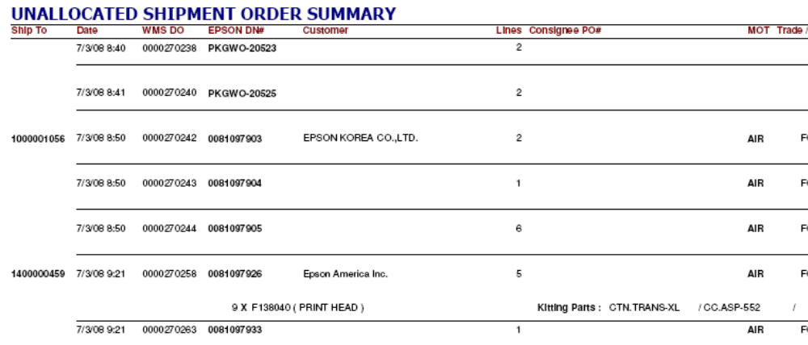
Applicable to Ship to code:1400000459 (Epson America Inc) Only
To separate DNs for Service Parts (Customer PO# prefix with “SA”) and Refurbishment Parts (Numeric Customer PO# with no prefix) during DN consolidation into Wave
119655
119655
SA03988S
SA03988S
SA03988S
119645
Ship to code:1400000459
Epson will send us the customer PO# in the 940 details. Schenker to perform the following:
1) Identity whether the DN is a service parts DN or refurbishment parts DN from the customer PO# in the 940 details.
2) Indicate the following in the “Unallocated Shipment Order Summary” – Consignee PO# field:
Service Parts for Customer PO# prefix with “SA”
Refurbishment Parts for Numeric Customer PO# with no prefix

